Slide 1

Types of
graphs
Graphs for
categorical variables
Graphs for continous variables
Examples
in R
Bibliography
Graphical analysis of data (I)
Marcin Chlebus, Ewa Cukrowska-Torzewska
Faculty of Economic Sciences
University of Warsaw
Lecture 4: 24-25.10.2017
Zajęcia 1. Wprowadzenie
Notes:
Wiem, że robiliście tak żeby fioletowy nie gryzł się z szarym, ale czerń i szarość przytła

Slide 2

Types of graphs
Types of
graphs
Graphs for
categorical variables
Graphs for continous variables
Examples
in R
Bibliography
Bibliography
O projekcie
R
Graphical visualization of data
Graphs for summarizing categorical variables
Graphs for summarizing continous variables
Graphs for the relation between two or more variables
Bar chart
Pie chart
Spine plot
Histogram
Kernel densities
Scatter plot
Box plot
Mosaic plots
Dot plot
Graphs for time-series data
Run chart
Other graphs
QQ plot
Violin plot

Slide 3
Categorical data
Types of
graphs
Graphs for
categorical variables
Graphs for continous variables
Examples
in R
Bibliography
Bibliography
O projekcie
R
Categorical data include:
Nominal data → the values cannot be ordered (e.g. male-female)
Ordinal data → the values can be ordered but the differences between the values are not informative (e.g. education level)
Discrete data → the values are counted (e.g. the number of children)
There is a certain number of values of the categorical variable that we want to plot!

Slide 4
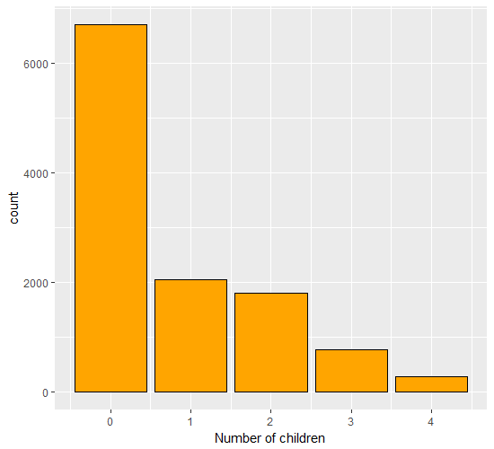
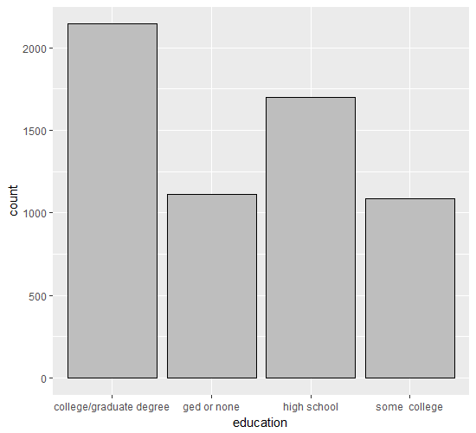
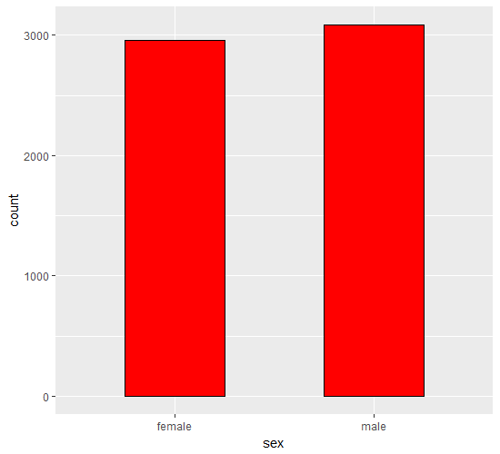
Bar chart
Types of
graphs
Graphs for
categorical variables
Graphs for continous variables
Examples
in R
Bibliography
Bibliography
O projekcie
R
Any categorical variable may be summarized by one-dimensional table
The easiest way to summarize the data is a bar chart, where the area of the bar represents the count for its category
Female | Male
2959 | 3085
college/ graduate degree | ged or none | high school | some college
2144 | 1114 | 1699 | 1087
0 | 1 | 2 | 3 | 4
6703 | 2051 | 1801 | 762 | 275

Slide 5
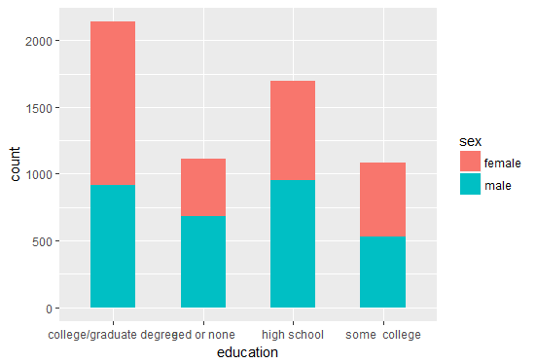
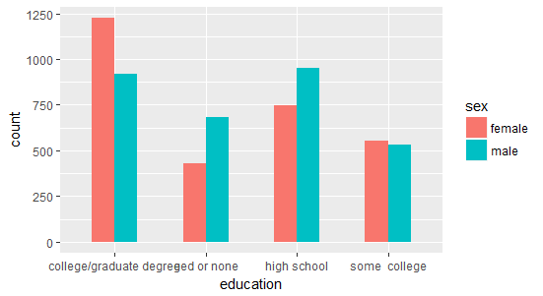
Bar chart
Types of
graphs
Graphs for
categorical variables
Graphs for continous variables
Examples
in R
Bibliography
Bibliography
O projekcie
R
In many situations it is desirable to look at the distribution of a subgroup of a categorical variable → e.g. education by gender

Slide 6
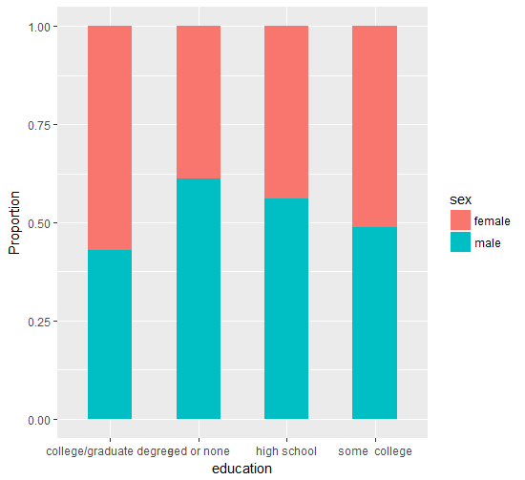
Spine plot
Types of
graphs
Graphs for
categorical variables
Graphs for continous variables
Examples
in R
Bibliography
Bibliography
O projekcie
R
While the bar chart shows the absolute counts of the subgroup, the spine plot shows the proportions

Slide 7
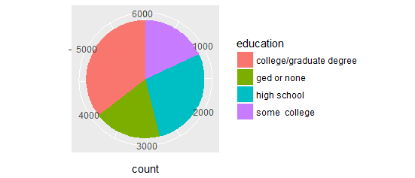
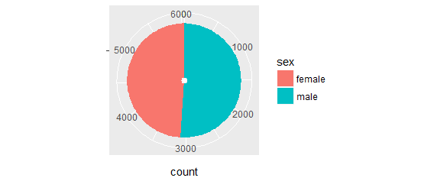
Pie chart
Types of
graphs
Graphs for
categorical variables
Graphs for continous variables
Examples
in R
Bibliography
Bibliography
O projekcie
R
Pie chart is also a useful chart to summarize proportions
Each „slice” of the pie represents the relative size of a given category in the data.

Slide 8
Graphs for categorical variables in R
Types of
graphs
Graphs for
categorical variables
Graphs for continous variables
Examples
in R
Bibliography
Bibliography
O projekcie
R
Exercise 1:
Install package „car” and use the dataset „Salaries” from that package. The dataset contains salaries of the nine-month academic salary for Assistant Professors, Associate Professors and Professors in a college in the U.S. Using the dataset:
identify categorical variables
visualize the data using the graphs for categorical variables.

Slide 9
Continous variables
Types of
graphs
Graphs for
categorical variables
Graphs for continous variables
Examples
in R
Bibliography
Bibliography
O projekcie
R
As opposed to discrete and categorical variables, which are counted, continous variables are measured.
Examples: lenght, height, weight,
wages, hours of work, prices, etc.

Slide 10
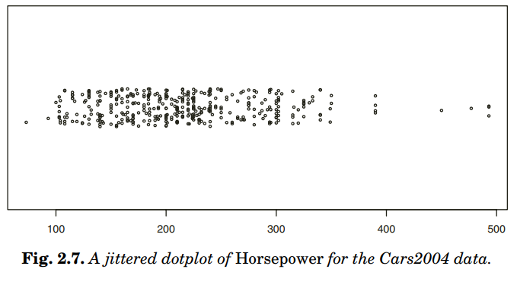
Dot plot
Types of
graphs
Graphs for
categorical variables
Graphs for continous variables
Examples
in R
Bibliography
Bibliography
O projekcie
R
The simpliest way to plot the values of one continous variable is the dot plot.
Because the points are distributed along only one axis, overplotting is a serious problem.
Source: Graphic of large datasets – Visualizing a Milion; Antony Unwin et al. (2006)

Slide 11
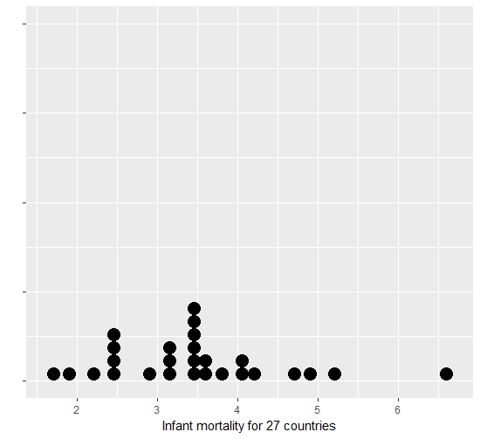
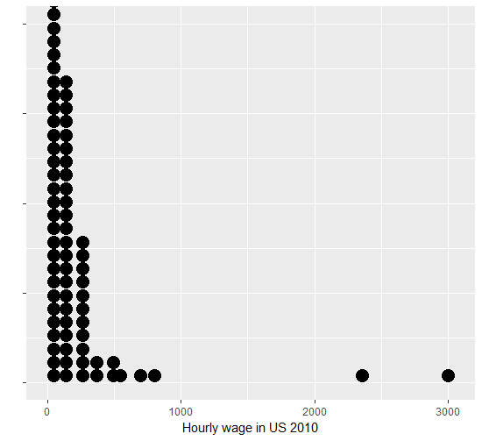
Wilkinson dot plot
Types of
graphs
Graphs for
categorical variables
Graphs for continous variables
Examples
in R
Bibliography
Bibliography
O projekcie
R
In this plot each dot represents one observation of a given value of x variable
It may not be efficient way of visualizing large datasets, but it performs well in the case of small samples

Slide 12
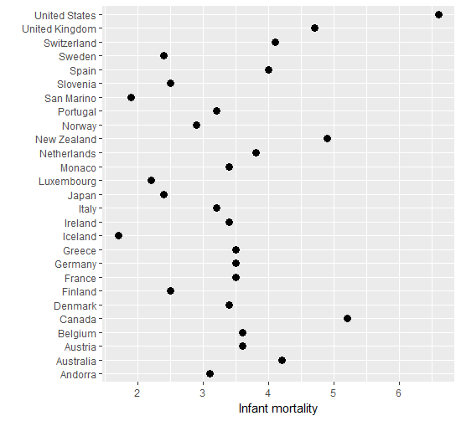
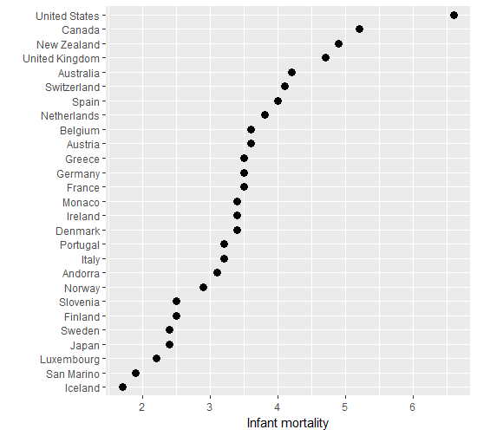
Cleveland dot plot
Types of
graphs
Graphs for
categorical variables
Graphs for continous variables
Examples
in R
Bibliography
Bibliography
O projekcie
R
Cleveland dot plots are sometimes used instead of bar graphs.
The main advantage of these plots over bar plots is that they are easier to read
They usually pertain to two variables

Slide 13
Dot plot
Types of
graphs
Graphs for
categorical variables
Graphs for continous variables
Examples
in R
Bibliography
Bibliography
O projekcie
R
Exercise 2:
Use the dataset „Salaries”.
Use simple dot plot to visualize data on Professors’ salaries.
What can you say about the distribution of the salaries based on this plot?
Use Wilkinson dot plot to visualize data on Professors' salaries.
What can you say about the distrubtion of the salaries based on this plot?
Try to use Cleveland dot plot to visualize data on Professor’s salaries.

Slide 14
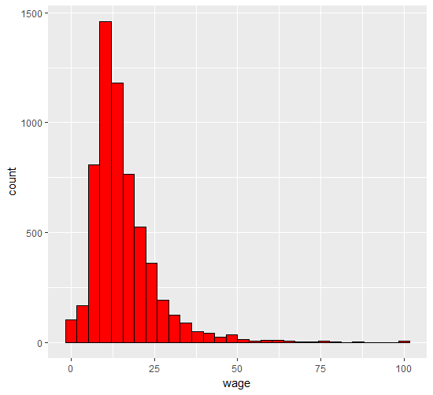
Histogram
Types of
graphs
Graphs for
categorical variables
Graphs for continous variables
Examples
in R
Bibliography
Bibliography
O projekcie
R
Histogram is very often used to represent counts
of the distribution of the continous variable.
The interpretation of the histograms makes them somewhat comparable to bar charts for categorical variables nd Wilkinson dot plots for small samples.
The difference between the histogram and the bar chart is that the number of the bins of a histogram is not determined a priori and the bins are set to represent the continous scale of the data (i.e. we need to create „categories” for the continous scale)
To determine histogram we need to specify bins width and the starting position of the first bin.

Slide 15
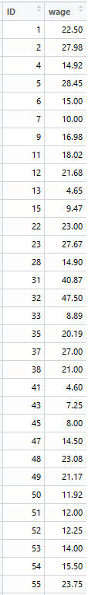
Histogram
Types of
graphs
Graphs for
categorical variables
Graphs for continous variables
Examples
in R
Bibliography
Bibliography
"Category" = bin | Count
0-5 | 105
5-10 | 169
10-15 | 809
15-20 | 1459
20-25 | 1179
25-30 | 764
30-35 | 525
35-40 | 361
40-45 | 192
45-50 | 126
50-55 | 90
55-60 | 50
60-65 | 41
65-70 | 26
70-75 | 36
75-80 | 15
80-85 | 6
85-90 | 9
90-95 | 10
95-100 | 6
100-105 | 2
105-110 | 4
110-115 | 8
115-120 | 4
120-125 | 1
125-130 | 2
130-135 | 1
135-140 | 1
140-145 | 0
145-150 | 7
O projekcie
R

Slide 16
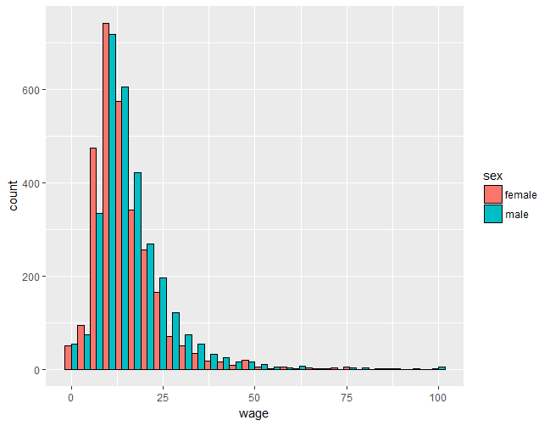
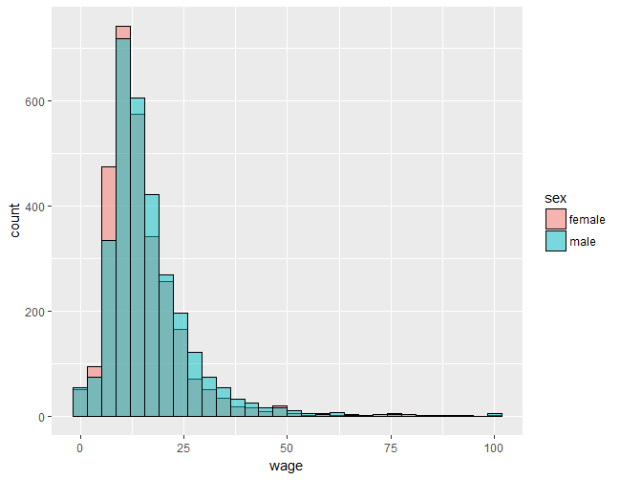
Histogram
Types of
graphs
Graphs for
categorical variables
Graphs for continous variables
Examples
in R
Bibliography
Bibliography
O projekcie
R

Slide 17
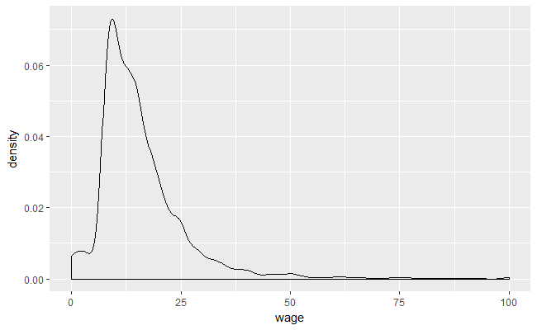
Density plot (kernel density)
Types of
graphs
Graphs for
categorical variables
Graphs for continous variables
Examples
in R
Bibliography
Bibliography
O projekcie
R
A density plot is a variation of histogram
that uses kernel smoothing function
to smooth the distribution.
Compared to histograms, density plots are better at determining the shape of the distribution because they are not affected by the number of bins
More formally, kernel smoothing functions smooth out the contribution of each observed data point (x) over a local neighborhood of that data point (x(i)):
The estimated density at any point x
Kernel function –
it determines the weight
given to each x at point x(i)
based on their proximity
Bandwidth = smoothing parameter =
the size of the neighborhood around x(i):

Slide 18
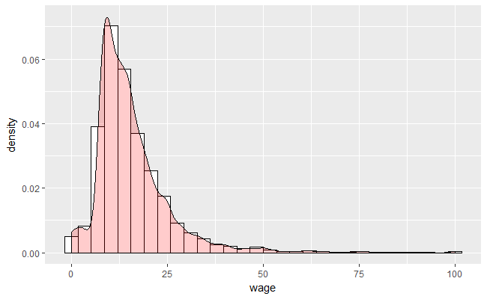
Density plot (kernel density)
Types of
graphs
Graphs for
categorical variables
Graphs for continous variables
Examples
in R
Bibliography
Bibliography
O projekcie
R

Slide 19
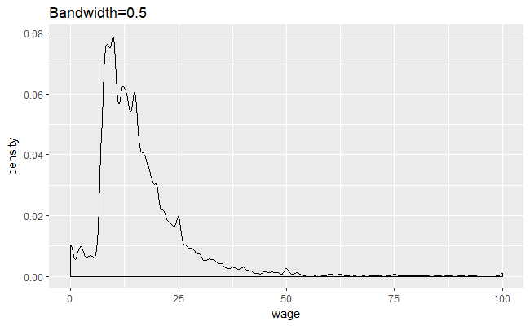
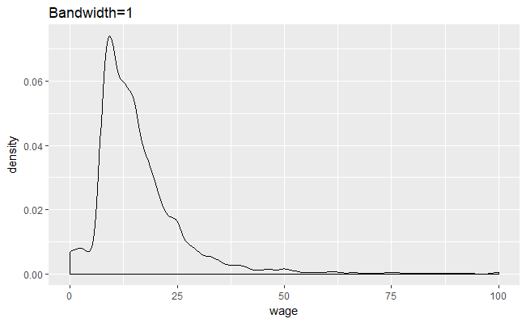

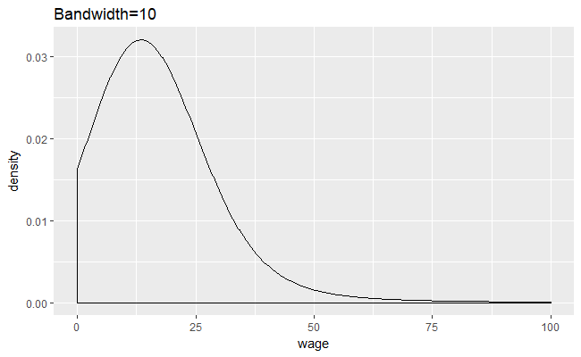
Density plot (kernel density)
Types of
graphs
Graphs for
categorical variables
Graphs for continous variables
Examples
in R
Bibliography
Bibliography
O projekcie
R
Too large h will oversmooth the data
Too small h will undersmooth the data

Slide 20
Histogram and density plot
Types of
graphs
Graphs for
categorical variables
Graphs for continous variables
Examples
in R
Bibliography
Bibliography
O projekcie
R
Exercise 3:
Use the dataset „Salaries”.
Create histograms and density plots for Professors’ salaries
Create histograms and density plots for Professors’ salaries by sex/rank/discipline
Intepret the graphs.

Slide 21
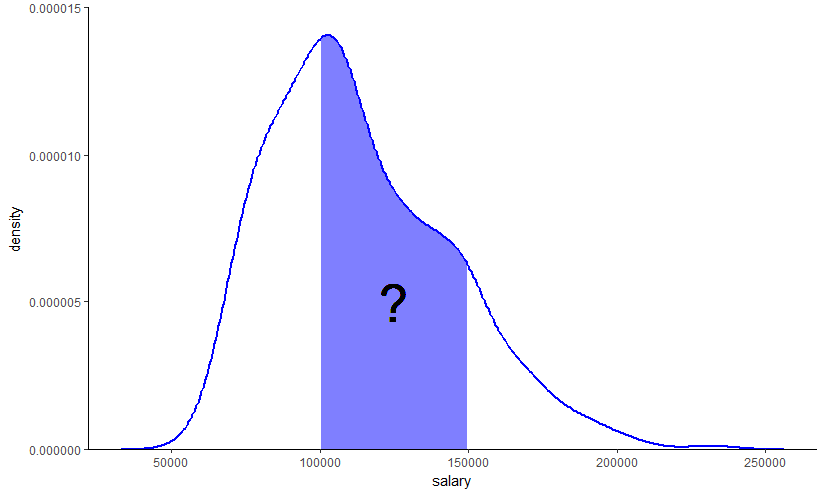
Histogram and density plot
Types of
graphs
Graphs for
categorical variables
Graphs for continous variables
Examples
in R
Bibliography
Bibliography
O projekcie
R
Exercise 4:
How will you interpret the area filled with blue on the following density graph?

Slide 22
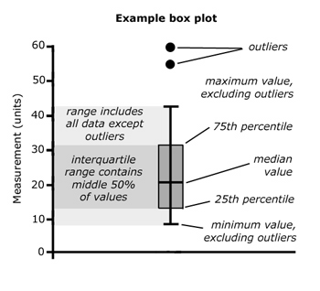
Box plot
Types of
graphs
Graphs for
categorical variables
Graphs for continous variables
Examples
in R
Bibliography
Bibliography
O projekcie
R
Boxplots are a mixture of summary information (like histograms) and information on individual points (like dot plots).
It summarizes the distribution by plotting quartiles.
Outliers are often plotted as individual points → boxplot is often used to detect outliers
Whisker – it is set using the IQR rule (1.5+/- IQR)
Box
Source: https://lon03.wordpress.com/

Slide 23
Box plot
Types of
graphs
Graphs for
categorical variables
Graphs for continous variables
Examples
in R
Bibliography
Bibliography
O projekcie
R
Exercise 5:
Create the boxplot for salaries data.
Based on your graph give answers to the following questions:
What are the range, the three quartiles and the interquartile range? Check your answers with calculating the relevant quartiles
If the 40th percentile is equal to 100 000, about how much of the sample earns between
91 000 and 100 000?
About how many outliers can you identify in the data?

Slide 24
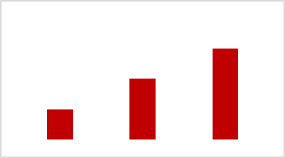
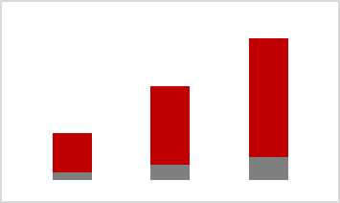
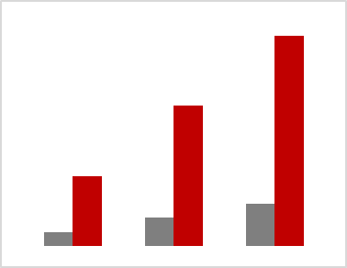

Data visualization in R
Types of
graphs
Graphs for
categorical variables
Graphs for continous variables
Examples
in R
Bibliography
Bibliography
O projekcie
R
 | Built in functions | Ggplot package
Simple bar chart | bars <- table(var1) barplot(bars) | ggplot(data=., aes(x=var1)+ geom_bar(stat="count")
Stacked bar chart | bars <- table(var1,var2) barplot(bars) | ggplot(data=., aes(x=var1, fill=var2))+ geom_bar(stat="count")
Grouped bar chart | bars <- table(var1,var2) barplot(bars, beside=TRUE) | ggplot(data=., aes(x=var1, fill=var2))+ geom_bar(stat="count", position="dodge")
Spine plot | spineplot(var1 ~ var2) | ggplot(data=., aes(x=var1, fill=var2))+ geom_bar(stat="count", position="fill")

Slide 25
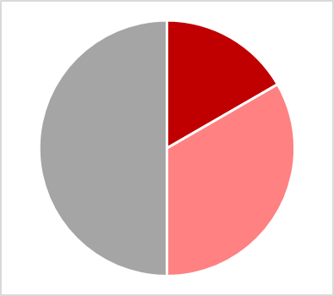
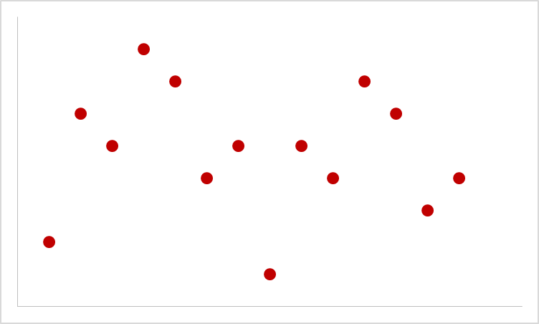
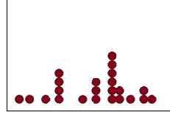
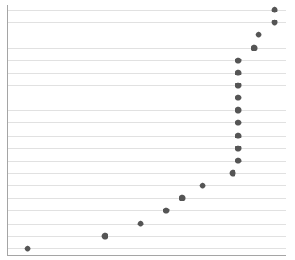
Data visualization in R
Types of
graphs
Graphs for
categorical variables
Graphs for continous variables
Examples
in R
Bibliography
Bibliography
O projekcie
R
 | Built in functions | Ggplot package
Pie chart | slices <- table(var1) pie(slices) | g <- ggplot(data=., aes(x="", fill=var1))+geom_bar() g + coord_polar(theta="y", start=0)
Dot plot | plot(var1, type='p') | NA
Wilkinson dot plot | Not available with built in funcitons. Can use: install.packages("BHH2") library(BHH2) dotPlot(var1) | ggplot(data=., aes(x=var1)) + geom_dotplot()
Cleveland dot plot | dotchart(var1) | ggplot(data=., aes(x=var1, y=reorder(var2, var1))) + geom_point()

Slide 26
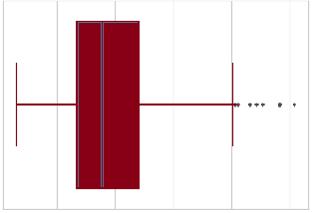
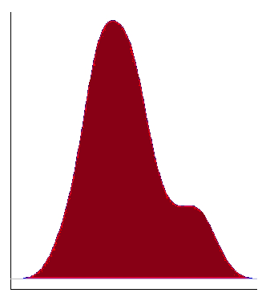
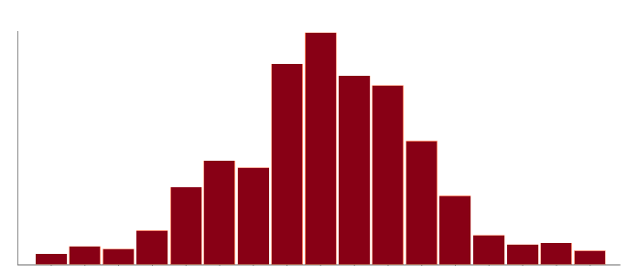
Data visualization in R
Types of
graphs
Graphs for
categorical variables
Graphs for continous variables
Examples
in R
Bibliography
Bibliography
O projekcie
R
 | Built in functions | Ggplot package
Histogram | hist(var1) | ggplot(data=., aes(x=var1)) + geom_histogram()
Kernel density | d <- density(var1) plot(d) | ggplot(data=., aes(x=var1)) + geom_density()
Boxplot | boxplot(var1) | ggplot(data=., aes(x="", y=var1)) + geom_boxplot()

Slide 27
Bibliography
Descriptive statistics
Measures of dispersions
Measures of
shape
Measures of dispersion and shape in R
Bibliography
Outliers
Bibliography
Antony Unwin, Martin Theus, Heike Hofmann, Graphics of Large Datasets Visualizing a Million. Springer 2006.
Winston Chang. Practical Recipes for Visualizing Data. R Graphics Cookbook. O’Reilly 2012.
For data visualization using ggplot:
http://r-statistics.co/Top50-Ggplot2-Visualizations-MasterList-R-Code.html
http://www.cookbook-r.com/Graphs/Plotting_distributions_(ggplot2)
Notes:
Green N(0,5); Blue N(0,0.5), Red N(0,1)

Slide 28
Thank you for your attention
Time for practice!

